Slide 1


CASHFLOW MINIMIZER SYSTEM
prepared by :
Tirth Patel (21002170310038)

Slide 2
INTRODUCTION
Description
Key Algorithms
This system minimizes the number of transactions among multiple banks in the different corners of the world that use different modes of payment. There is one world bank (with all payment modes) to act as an intermediary between banks that have no common mode of payment.
getMinIndex: Finds the bank with the minimum net amount.
getSimpleMaxIndex: Finds the bank with the maximum net amount.
getMaxIndex: Identifies the bank with the maximum net amount and a common payment type with the bank having the minimum net amount.
Data Structures Used
Approach
bank Class: Holds information about each bank.
Vectors: Represent the graph of transactions.
Sets: Efficiently manage unique payment modes.
The project adopts a modified Minimum Spanning Tree algorithm to iteratively settle debts among banks.

Slide 3
ALGORITHM EXPLANATION
Iteration:
1
Initialization:
2
Repeat the following steps until all net amounts are zero:
Find the bank (let's call it X) with the minimum net amount (max debtor).
Find a bank (let's call it Y) with the maximum net amount (max creditor) that also shares a common payment mode with X.
Calculate the minimum of the absolute values of net amounts of X and Y (let's call it z).
Perform the transaction: X pays the amount z to Y.
Each bank is represented by a bank class, containing information about its name, net amount, and supported payment modes.
Calculate the net amount for each bank using the formula: net amount=Sum of all credits−Sum of all debitsnet amount=Sum of all credits−Sum of all debits
3
Transaction Settlement:
Depending on the magnitude of the net amounts:
If ∣X∣< Y : X is completely settled and removed from the list.
If ∣X∣> Y : Y is completely settled and removed from the list.
If ∣X∣=Y: Both X and Y are completely settled and removed from the list.
Repeat:
4
Repeat the above steps for the remaining banks until all net amounts are zero.

Slide 4
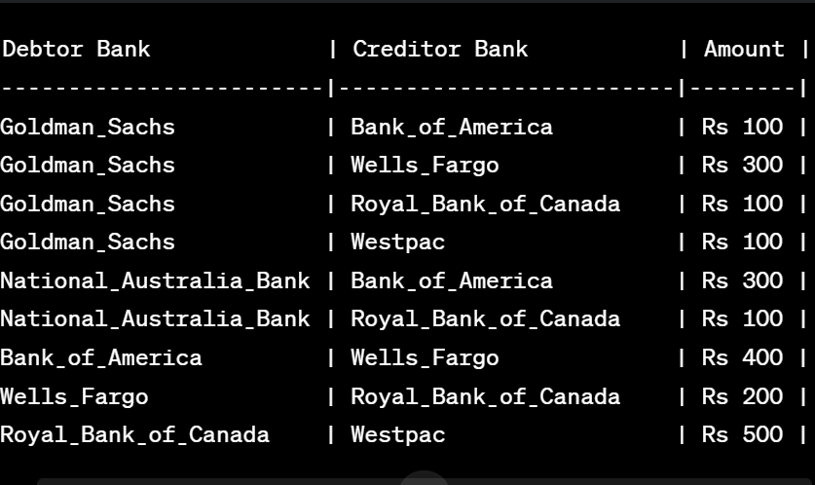
SCENARIO
Let's take an example. say we have the following banks:
Bank_of_America (World bank)
Wells_Fargo
Royal_Bank_of_Canada
Westpac
National_Australia_Bank
Goldman_Sachs
the payments to be done on the right

Slide 5
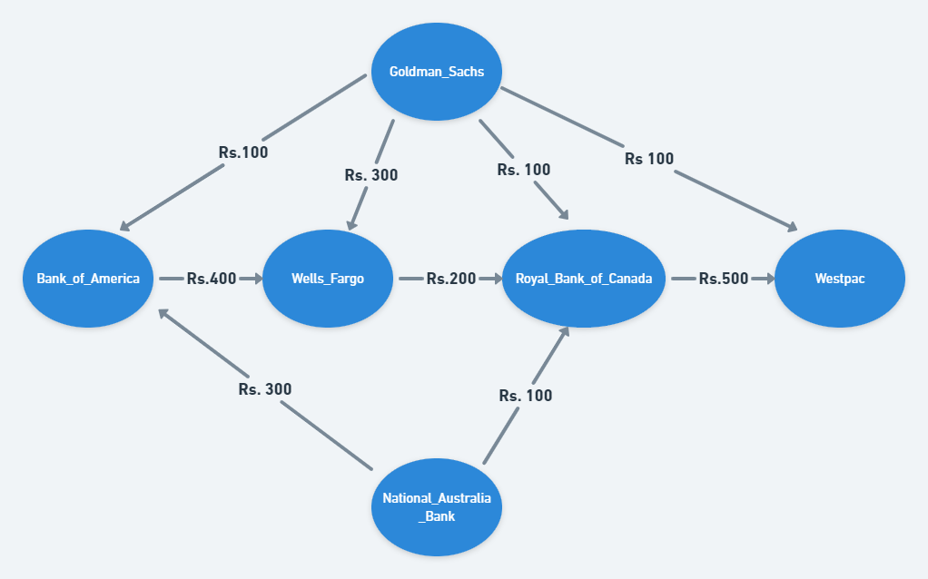
Each Bank only supports a set of modes of payments and can make or receive payments only via those. Only World Bank suppports all modes of payments. In our current example we have only three payment modes :
Google_Pay
AliPay
Paytm
Following is the list of Banks and their supported payment modes :
Bank_of_America - Google_Pay, AliPay, Paytm
Wells_Fargo - Google_Pay, AliPay
Royal_Bank_of_Canada - AliPay
Westpac - Google_Pay, Paytm
Goldman_Sachs - Paytm
National_Australia_Bank - AliPay, Paytm

Slide 6
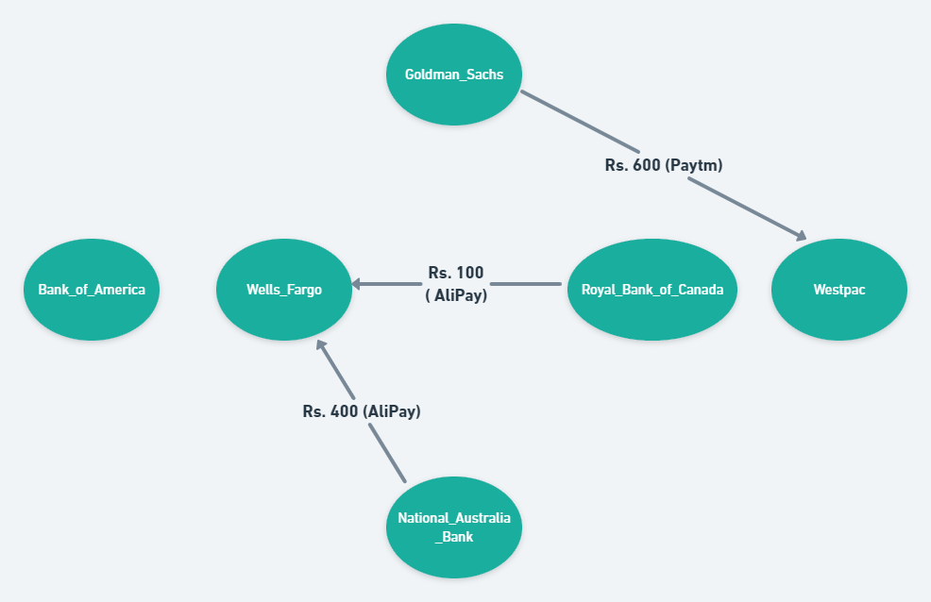
To pick the first Bank, we calculate the net amount for every Bank by using the below formula and store them in list:
net amount = [Sum of all credits(amounts to be received)] - [Sum of all debits(amounts to pay)]
Now the idea is that we are finding the bank which has minimum net amount(max debtor) (say Bank X, net amount x) and then finding the bank which has the maximum net amount( max creditor) (say Bank Y, net amount y) and also has a common payment mode (say M1) with the former bank. Then we find minimum of absolute value of x and y, lets call it z.
Now X pays the amount z to Y. Then 3 cases may arrived:
If (magnitude of x) < y => X is completely settled and so removed from the list.
If (magnitude of x) > y => Y is completely settled and so removed from the list.
If (magnitude of x) = y => X and Y both are completely settled and so both are removed from the list.
The same process is repeated for the remaining banks.
For the current example, the transactions for minimum cash flow are as follows:

Slide 7
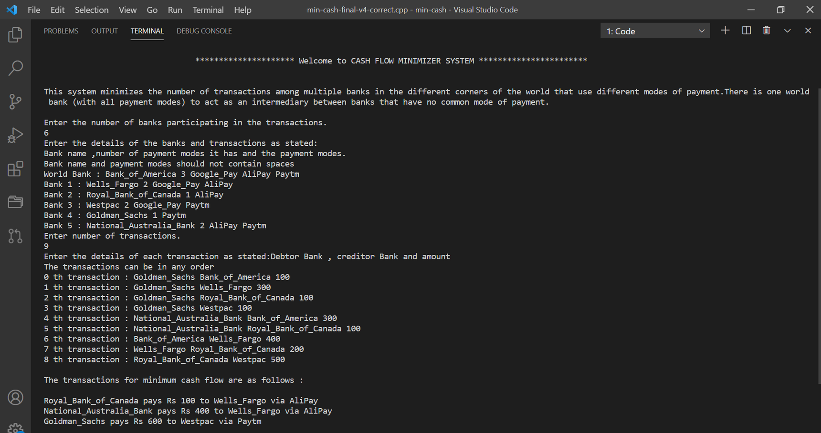
SAMPLE OUTPUT

Slide 8
THANK YOU

